Slide 1

A Quick Over-Vue.js
github.com/ironpilot/vuejs-intro/

Slide 2
About Vue.js
Small ~20k min+gzip
Very Performant:
https://www.stefankrause.net/js-frameworks-benchmark6/webdriver-ts-results/table.html
Easy to Learn if you know JavaScript, CSS and HTML already.
Can be added to part of an already existing project.
Supports advanced features like routing, and state management.
Open Source: https://github.com/vuejs/vue
Homepage: http://vuejs.org
Created By Evan You, February 2014

Slide 3
A Few Terms
DOM
Document Object Model, or all of the HTML elements that make up the webpage.
Virtual DOM
How Vue keeps track of and applies changes to the DOM. A technology shared by Vue and React. More on this later…
Component or Web Component
An encapsulated piece of code that has a single responsibility containing all of the HTML, CSS and JavaScript to perform the designed function.
SPA – Single Page Application
A JavaScript application that creates the illusion of multiple pages by loading content dynamically and updating the DOM as needed. (No Refresh)

Slide 4
A Few Terms (cont.)
Progressive Web Application
A web application that has the feeling of a natural device application. They provide extra functionality such as working offline, push notifications and can have native hardware access.
Promise
A JavaScript object that represents the eventual completion (or failure) of an asynchronous operation, and its resulting value. Used a lot with HTTP calls.

Slide 5
Example Repository
git clone git@github.com:ironpilot/vuejs-intro.git
Includes 13 example sites with solutions.

Slide 6
Your First Vue Page
Template
Double Mustache Syntax for outputting values: {{ value }}
Important to have clean and valid HTML markup here.
Support for directives (or special html attributes) for example:
v-if, v-for, v-on
Vue Instance
Contains the JavaScript code to make your app or component function.
.el refers to the root element where the Vue templating will start.
.data holds all the data properties for the Vue instance.

Slide 7
Example 1 (Hello Vue)
This will be your first Vue Application!
Start with a simple HTML file and inject Vue.js in the header:
<script src="https://cdn.jsdelivr.net/npm/vue/dist/vue.js"></script>
Now practice creating a Vue app:
<script> var app = new Vue({ el: '#app’, data: { message: 'Hello Vue!’ } }) </script>
Finally experiment with different data variables and injecting them into the template.

Slide 8
Conditionals (v-if, v-else, v-show)
v-if, v-else
Called Directives
Determines if an element exists in the DOM based on the condition applied.
Elements are created and destroyed from the HTML DOM.
v-show
Determines if the element should be shown or hidden based on the condition applied.
IMPORTANT: The element still exists in the DOM.

Slide 9
Example 2 (Conditionals)
Practice conditionals by making the DOM react to a data property.
Starting Site: /2-conditionals/start.html
TASK: Make the two divs show or hide depending on whether the user is a winner.
Base the show and hide on a data property in the Vue object. You will need to make this object.
EXTRA: Use the classes above to apply styles to the divs.
https://vuejs.org/v2/guide/index.html#Conditionals-and-Loops

Slide 10
The Vue Instance
A Vue application starts with a root view instance.
Loosely inspired by the MVVM (Model, View, ViewModel) pattern.
.el
The template that will be rendered by the Vue Instance.
.data
Vue data properties. Or all of the variables in your app or component.
.methods
Just like the methods in any other OOP language. A collection of functions that encapsulate functionality in your code.
.computed
Dynamic data properties. More on these later.
And more…

Slide 11
Methods
.methods
The .methods key on the Vue instance houses custom methods.
Following JSON syntax, the method must have a name and then reference a function.
var app = new Vue({
el: '#app',
data: {
message: ‘Hello Vue’
},
methods: {
convertToCelsius: function(degreesF) {
return (degreesF – 32) * 5/9;
}
}
})

Slide 12
Events & Methods (v-on)
Events are an action or occurrence that the software can react to.
The v-on directive allows us to react to user events.
v-on is generally connected to a method to handle the event.
Sample events:
v-on:click
v-on:submit
Shorthand:
@click

Slide 13
Event Modifiers & Key Modifiers https://vuejs.org/v2/guide/events.html#Event-Modifiers
Event Modifiers
Key Modifiers
.stop
.prevent
.capture
.self
.once
.passive
.enter
.tab
.delete (captures both “Delete” and “Backspace” keys)
.esc
.space
.up
.down
.left
.right

Slide 14
Example 3 (Methods & Events)
Modify the Conditionals example to make it more useful.
Starting Site: /3-methods/start.html
TASK: Make a button that selects a winning or none winning div.
Attach an event listener to the button.
The two divs should both be hidden until the button is clicked.
Use a random function to making winning random.
https://vuejs.org/v2/guide/index.html#Handling-User-Input

Slide 15
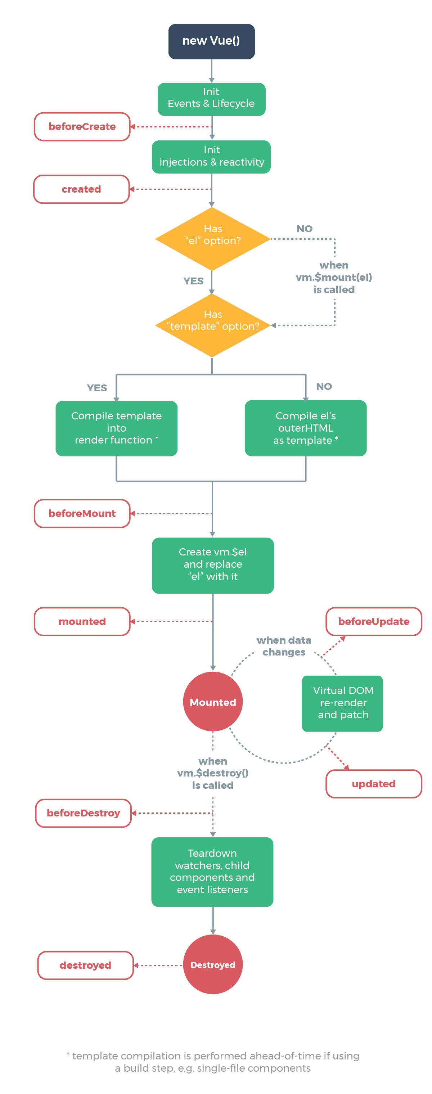
The Vue Lifecycle

Slide 16
The Vue Lifecycle

Slide 17
Example 4 (Vue Lifecycle)
Modify the Methods & Events example to make it even more useful.
Starting Site: /4-lifecycle/start.html
TASK: Make the winning div selected when the page loads.
Use a lifecycle method to execute the winner selection.
https://vuejs.org/v2/guide/instance.html

Slide 18
List Rendering
<ul id="v-for-object" class="demo">
<li v-for="value in list">
{{ value }}
</li>
</ul>
<script>
new Vue({
el: '#v-for-object',
data: {
list: {
firstName: 'John',
lastName: 'Doe',
age: 30
}
}
})
</script>
v-for
Iterates through an object.
Can be a JavaScript Array or an Object

Slide 19
List Rendering Gotchas
v-for cannot detect direct changes to an array if done by indexes.
Ex: array[1] = “five”; //Would not be detected.
Instead use:
listArray.splice(indexOfItem, 1, newValue);
Vue.set(listArray, indexOfItem, newValue);
v-for cannot detect the addition of dynamic properties to objects
Given: var a = {b:”value”};
You cannot: a.c = “New value”;

Slide 20
Example 5 (Lists)
Practice list rendering with a new task!
Starting Site: /5-list-rendering/start.html
TASK: Make a bucket list of things you would like to do in your lifetime.
Store the list in a data property.
Render the list to the page by using a v-for directive.
https://vuejs.org/v2/guide/list.html

Slide 21
Computed Properties
<li v-for="n in evenNumbers">{{ n }}</li>
data: {
numbers: [ 1, 2, 3, 4, 5 ]
},
computed: {
evenNumbers: function () {
return this.numbers.filter(function (number) {
return number % 2 === 0
})
}
}
A computed properties acts like a data property, but it is written as a function.
DOM elements that use computed properties are only updated when the actual value of the computation changes.
Useful for filtering lists.

Slide 22
Example 6 (Computed Properties)
Enhance list rendering with a computed property.
Starting Site: /6-computed-properties/start.html
TASK: Create a list of numbers 1 through 20 and filter the list by only prime numbers.
Store the list in a data property.
Render the list to the page by using a v-for directive.
Create a computed property to filter the list to only prime numbers.
EXTRA: Create a button to add numbers to the list.
https://vuejs.org/v2/guide/computed.html

Slide 23
Form Input Binding
<input type="text" v-model="userName" value="">
<script>
var app = new Vue({
el: '#app',
data: {
message: 'Prime Numbers',
userName: '',
}
})
</script>
Also called two-way binding or view model.
Use v-model to associate a data property with a form field.
This creates a two-way binding. If the data property value changes, the field value is updated and vice versa.

Slide 24
Example 7 (Form Binding)
Use form binding to record the entries in a form.
Starting Site: /7-form-binding/start.html
TASK: Create a registration form and display the submitted data.
Create a contact form with fields for name, phone number and email address.
Bind all of the form elements to data properties using v-model
Display the contents of the form when the form is submitted.
https://vuejs.org/v2/guide/forms.html

Slide 25
Components
Components are reusable Vue instances with a name.
Used to create custom DOM elements.
.data is now a function.
Templates must have a single root element
Vue.component('button-counter', {
data: function () {
return {
count: 0
}
},
template: '<button v-on:click="count++">You clicked me {{ count }} times.</button>'
})

Slide 26
Passing In Data with Props
Props are custom attributes you can register on a component.
Props can have a defined type, like Boolean, Array, Number, etc.
Props can be static or dynamic by adding a v-bind directive to the prop.
Creates a one-way flow or binding into the child component.
Vue.component('button-counter', {
data: function () {},
props: [‘count’],
template: '<button v-on:click="count++">You clicked me {{ count }} times.</button>'
})
https://vuejs.org/v2/guide/components.html#Passing-Data-to-Child-Components-with-Props

Slide 27
Prop Types and Validation
Vue.component('my-component', {
props: {
// Required string
propC: {
type: String,
required: true
},
// Number with a default value
propD: {
type: Number,
default: 100
},
}
})
Components can specify requirements for it’s props like:
Prop Type
Requirement
Defaults Values
Useful when creating a component that will be used by others.
Best practice is to always include types and requirements in components.

Slide 28
Example 8 (Components)
Create our first web component!
Starting Site: /8-components/start.html
TASK: Create a simple microblog.
Create a component to represent a single “tweet”.
Pass in the author and tweet message as a prop.
Allow each tweet to be voted up or voted down.
EXTRA: Add prop types and validations for each prop.
https://vuejs.org/v2/guide/components.html

Slide 29
Custom Events
You can create custom events using:
this.$emit(‘event-name’);
$emit() is a built in Vue function.
Events name are case-sensitive except when listened for in the DOM.
Listen for custom events like you would any other event:
@event-name=“doSomething()”

Slide 30
Passing Data Out with Custom Events
$event is a special variable that can be passed to an event method.
Contains the DOM element that the event occurred on.
Any type of data can be passed using $emit(), even Arrays and Objects.
this.$emit(‘my-event’, “A Data String”);
<my-component @my-event=“handleEvent($event)”></my-component>
handleEvent(data) {
this.property = data;
}

Slide 31
Example 9 (Custom Events)
Practice passing data up the component tree with custom events.
Starting Site: /9-custom-events/start.html
TASK: Modify the previous app with a combined reputation value for the tweets.
Create a custom event to add a reputation to the base thread
The reputation will be a simple sum of the total up votes and down votes from all of the tweet components.
EXTRA: Create a separate reputation value for each of the authors.
https://vuejs.org/v2/guide/components-custom-events.html

Slide 32
Webpack & Vue CLI
A more advanced workflow.

Slide 33
Vue CLI
Used for scaffolding, building, and testing projects.
Similar idea to Symfony’s bin/console but with a different set of features.
Includes an optional web GUI.
Install (Globally)
npm install -g @vue/cli
Commands
create [options] <app-name>
add <plugin> [pluginOptions]
invoke <plugin> [pluginOptions]
inspect [options] [paths...]
serve [options] [entry]
build [options] [entry]
ui [options]
init [options] <template> <app-name>
config [options] [value]

Slide 34
Create Project (w/CLI)
To create a new project with Vue CLI:
vue create hello-world
Projects can also be created through the Vue UI:
vue ui
Babel
TypeScript
Progressive Web App (PWA) Support
Router
Vuex
CSS Pre-precessors
Linter / Formatter
Unit Testing
E2E Testing
Notes:
Babel - Used by WebPack to convert your ECMAScript 2015+ code into a backwards compatible version of JavaScript.
TypeScript - A typed superset of JavaScript that compiles into JavaScript.
PWA - Web apps that take advantage of the latest technologies to combine the best of web and mobile apps. Designed act and feel like an app. This option adds a Service Worker and some mobile friendly icons.
Service Worker - A script that runs in the background separate from the web site. Includes features like push notifications and background sync.
Router - Used to sync URL’s to the views in the app.
Vuex - Its job is to share data across the components of your application. A centralized data store that any component can listen to for changes.

Slide 35
Demo - Project Files And How It All Fits Together
index.html
The starting point of the website.
Webpack auto injects compiled files in the index.html
Spot to attach to: <div id="app"></div>
main.js
Imports the App.vue component
Creates a new Vue instance and mounts it to #app
Lazy loads the App component
App.vue
Imports the HelloWorld component
Registers the HelloWorld component
The HelloWorld component in the template is passed a msg property.
HelloWorld.vue
Has a msg property that is passed in
Uses the msg property in the template
Has scoped styling

Slide 36
Single File Components (.vue)
<template>
<p>{{ hello }}</p>
</template>
<script>
export default {
data() {
return {
hello: 'Hello World!'
}
}
}
</script>
<style scoped>
p {
color: blue;
}
</style>
The introduction of Webpack presents us with Single File Components or .vue files.
These contain JavaScript logic, HTML code template, and CSS styling all in one.
We can use modern JS, like ES6.
HTML templates must have ONE root element between the <template> tags.
Styles can be “scoped”, which means all of the CSS styles are unique to this component.

Slide 37
Sub Components
Components can be children of other components.
This develops a Component tree.
Sub Components should have only a single responsibility.

Slide 38
ECMAScript 6+ (ECMAScript 2015)
Newest features of JavaScript are made available for use without having to worry about browser support.
Babel is used by WebPack to convert your ECMAScript 2015+ code into a backwards compatible version of JavaScript.
Default Parameters
Template Literals
Multi-line Strings
Destructuring Assignment
Enhanced Object Literals
Arrow Functions
Promises
Block-Scoped Constructs Let and Const
Classes

Slide 39
Vue Serve
To run a local server for your webpack site use:
npm run serve
This will actively compile your assets as you code and rebuild the page.

Slide 40
HTTP Calls with Axios
Promise based HTTP client for browser and node.js
Uses callback functions to react to success or failure of HTTP calls.
Axios HTTP GET Example:
axios.get(‘http://url.to/endpoint’) .then(callbackFunction()) .catch(callbackFunction())
https://github.com/axios/axios
Install to Project
npm install --save axios
Import to Component
import axios from 'axios’;
Axios HTTP POST:
axios .post(‘http://url.to/endpoint’, { //JSON Data }) .then(function() { //Do Something }) .catch(function() { //Handle Error })

Slide 41
More About Promises
An object that represents the eventual complete or failures of an asynchronous operation and its resulting value.
Not supported natively in Internet Explorer.
High Potential for Race Conditions Consider the following code. Which order with the console logs output in?
axios.get('http ://url.to/endpoint’) .then(function() { console.log('Completed Request');
});
console.log('Done.');

Slide 42
Example 11 (Weather App)
{
"METAR": [{
"raw_text": "KBOI 191653Z 27010KT 10SM CLR…",
"station_id": "KBOI",
"observation_time": "2018-09-19T16:53:00Z",
"latitude": "43.57",
"longitude": "-116.23",
"temp_c": "17.2",
"dewpoint_c": "0.6",
"wind_dir_degrees": "270",
"wind_speed_kt": "10",
"visibility_statute_mi": "10.0",
"altim_in_hg": "29.958662",
"sea_level_pressure_mb": "1010.3",
"sky_condition": {
"sky_cover": "CLR"
},
"elevation_m": “875.0"
}]
}
TASK: Connect to an API and display information to the page.
Add a search box to search for a weather station.
Call the API to retrieve weather information.
Display the weather information to the end user.
Starting Site: /11-http-with-axios/axios-start/
Run: npm install
API:
http://aviationweather.autopilotstudios.com/metar/recent/KBOI
https://github.com/axios/axios

Slide 43
Vue Router
Allows areas of the page to be easily replaced to create the illusion of a page change without a browser refresh.
Supports Route Parameters, Query Strings and Wildcards
Combine with Transitions
HTML5 History Mode/Hash Mode
Populates browser history
Auto-fallback in IE 9

Slide 44
Vue Router
Router View
This component adds a “viewport” that the router outputs into source code
<router-view></router-view>
Routes
Can be nested
Can be navigated to programmatically
router.push(location, onComplete?, onAbort?)
Create a Vue Router
const router = new VueRouter({ routes: [ // dynamic segments start with a colon { path: '/user/:id', component: User} ] })
Lazy Loading
{ path: ‘/about’, name: ‘about’, component: () => import( /* webpackChunkName: "about" */ './views/About.vue’) }

Slide 45
Router Links
To make a link (change pages) in the SPA we need to use the RouterLink component
<router-link to=“/my-page”>Some Text</router-link>
This replaces <a> tags, but it can generate other tags like <button> tags as well.
<router-link to=“/cart” tag=“button”>View Cart</router-link>
Active Links
<router-link to=“/my-page” active-class=“active”> Some Text </router-link>
Exact route matches
<router-link to=“/my-page” active-class=“active” exact> Some Text </router-link>

Slide 46
Navigation Guards
Used to:
Prevent a user from accessing a page.
Prevent a user from leaving a page.
A guard can execute either before or after a route has executed.
Can be setup globally or per route.
Global Guard
router.afterEach((to, from) => {})
Per Route Guard
const router = new VueRouter({ routes: [ { path: '/foo’, component: Foo, beforeEnter: (to, from, next) => {} } ] })

Slide 47
Example 12 (Hello Router)
Used to sync URL’s to the views in the app.
In a SPA the server will fallback to index.html if the URL is not found.
The client side router takes care of the routing.
Build and Watch
npm run build:watch
Install and run HTTP Server
npm install -g http-server http-server-spa
http-server dist vs http-server-spa dist
https://router.vuejs.org/

Slide 48
Example 12 (Hello Router Cont.)
New Components
Authors - Shows all authors.
Author - Shows a single author.
main.js
Router is imported and added to the main Vue component.
App.vue
Has router-links (render like html anchors)
Has a router-view to output the router’s selected component
router.js
Look at the existing routes
Add a couple routes and import their components:
Authors - /authors
Author - /authors/{ID}
Try it out!
https://router.vuejs.org/

Slide 49
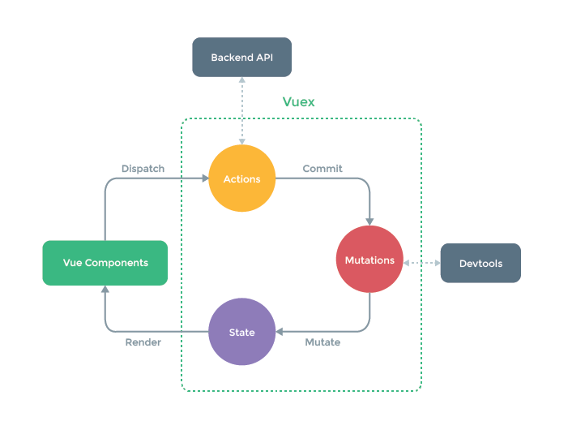
Vuex – State Management in Vue.js
Based on Redux and Flux
Single State Tree (Single Source of Truth)
What does state management solve?
Passing data between sibling components
Updating multiple components Simultaneously
Multiple different views need to update the same data

Slide 50
Vuex Store
.state
These are the data elements that represent the application state.
.getters
Computed properties for stores.
.mutations
Methods that act upon the data (setters).
.actions
Methods that commit mutations.
export default new Vuex.Store({
state: {
},
getters: {
}
mutations: {
},
actions: {
}
})

Slide 51
Vuex State
Accessing store properties from a component
this.$store.state.count
Mapping the state to computed properties
computed: { ...mapState(['count’]) }
Each component can still have a local state.
Provide the store to components:
const app = new Vue({ el: '#app’, // providing the store using the "store" option. // will inject into to child components. store, components: { Counter }, template: `<div class="app"></div>` })

Slide 52
Vuex Getters
Sometimes we may need to compute derived state based on store state.
For example filtering through a list of items and counting them.
Mapping Getters to a Component
computed: { ...mapGetters([ 'doneTodosCount’, 'anotherGetter’, ]) }
Define Getter
getters: { doneTodos: state => { return state.todos.filter( todo => todo.done ) } }
Access Like a Property
store.getters.doneTodos

Slide 53
Vuex Mutations
Mutations act upon the state properties. (Setters)
Must be synchronous
Mapping Mutations on Components
methods: { ...mapMutations(['increment’]) // map this.increment() to `this.$store.commit('increment’) }
Define Mutation
mutations: { increment (state, n) { state.count += n } }
Execute a Mutation
store.commit(‘increment’, 10);

Slide 54
Vuex Actions
Actions are similar to mutations, the differences being that:
Instead of mutating the state, actions commit mutations.
Actions can contain arbitrary asynchronous operations.
Mapping Actions on Components
methods: { ...mapActions([‘increment’]) }
Define Action
actions: { increment (context) { context.commit('increment’) } }
Execute an Action
store.dispatch('increment')

Slide 55
Vuex Modules
Due to using a single state tree, all state of our application is contained inside one big object.
Vuex allows us to divide our store into Modules.
Each module can contain its own state, mutations, actions, getters, and even nested modules
By default, actions, mutations and getters inside modules are still registered under the global namespace.
If you want your modules to be more self-contained or reusable, you can mark it as namespaced with namespaced: true

Slide 56
Example 13 (Puppy Shop)
TASK: Finish the ecommerce site by adding product drill down and shopping cart features.
Data already populated in the Vuex store. Retrieve to create product lists.
You may need to use getters to create filters from the product list.
Create a shopping cart component and add the methods to add, remove and show the cart.
Starting Site: /13-vuex/vuex-start/
Run: npm install
https://vuex.vuejs.org/

Slide 57
Vue Devtools (Chrome Extension)
Allows for advanced debugging of Vue.js Applications.
Inspect separate components for contents.
Watch for firing of custom events.
Inspect the contents of Vuex stores.
Extra Configuration (chrome://extensions/)
Allow in incognito
Allow access to file URLs

Slide 58
Resources
Vue Mastery: https://www.vuemastery.com/
Vue JS 2 – The Complete Guide: https://www.udemy.com/vuejs-2-the-complete-guide
Vue Devtools: https://chrome.google.com/webstore/detail/vuejs-devtools/nhdogjmejiglipccpnnnanhbledajbpd
Comparison of Angular, React and Vue: https://medium.com/unicorn-supplies/angular-vs-react-vs-vue-a-2017-comparison-c5c52d620176
Vue Handbook: https://medium.freecodecamp.org/the-vue-handbook-a-thorough-introduction-to-vue-js-1e86835d8446
Progressive Web Application Checklist: https://developers.google.com/web/progressive-web-apps/checklist

